Slide 1
Chapter 6: part 2
Data Conversion
By
Dr. Mohammad Arif Sobhan Bhuiyan
Electrical and Electronics Engineering
Xiamen University Malaysia

Slide 2
Introduction
Analog to digital or digital to analog conversion is an important aspect of a digital system.
Advantages of Digital:
Relatively less sensitive to distortion (noise and losses)
Can be reproduced much more accurately
Much easier to reconstruct a signal
More storage options
Can be processed mathematically and logically
Easier to standardize
Systems are easier to design (fewer voltage / current issues)
Digital systems can be made small (low current)
Display options

Slide 3
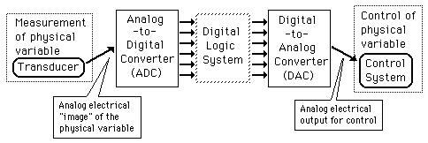
Basic digital system
Digital processing
Both data about the physical world and control signals sent to interact with the physical world are typically "analog" or continuously varying quantities.

Slide 4
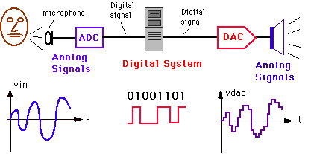
ADC/DAC example
Analog to digital converter (ADC) and digital to analog converter (DAC) are used to interface a digital system (such as computer) to the analog world so that it can monitor and control a physical variable.
Fig 1

Slide 5
Challenges with ADC
Converting an analog value to digital values comes with disadvantages:
  It takes time to convert a signal from Analog to Digital, and then to process that signal. May be too slow for some applications.
  Never 100% reproduction…always a series of discrete values.
  Requires more complex circuit design
    More faithful reproduction requires more bit of resolution.
    Requires other circuit elements such as oscillators and memory systems.

Slide 6
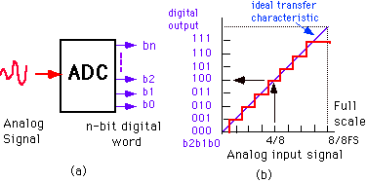
Analog to Digital Conversion (ADC)
The ADC will translate a continuous time signal into a discrete time signal by sampling it at specific intervals.
These samples become the input to the ADC
  The ADC then follows the step of quantization to generate the digital representation of the samples.
The process continues for a certain period of time.
  The result is a sequence of digital values that will represent the analog signal values during the given time period.
Fig 2

Slide 7
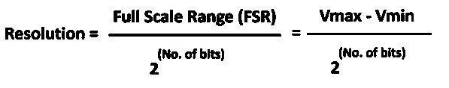
Analog to Digital Conversion (ADC)
An ADC is characterized by its range and its resolution.
  The range refers to the smallest and largest number (signal amplitude) the ADC can convert.
    The range is a function of the circuitry used to construct the ADC.
  The resolution refers to the number of bits used to represent a sample value.
    The higher the number of bits, the more accurately an analog value can be reconstructed from its binary representation.

Slide 8
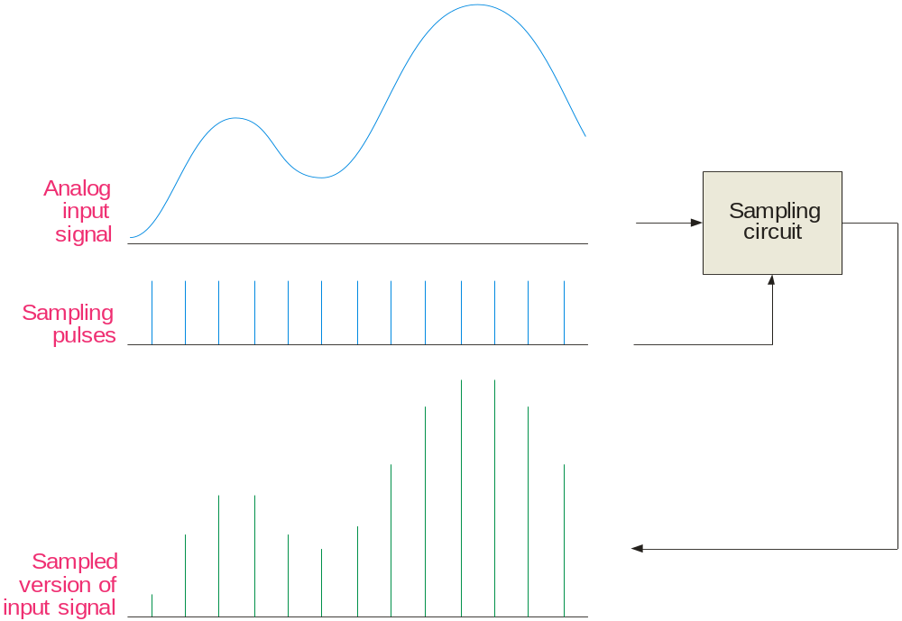
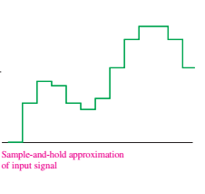
Sampling
Most input signals to an electronic system start out as analog signals. For processing, the signal is normally converted to a digital signal by sampling the input.
Fig 3

Slide 9
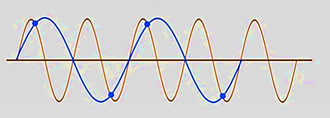
Sampling
To understand the need for an anti-aliasing filter, you need to understand the sampling theorem which essentially states:
In order to recover a signal, the sampling rate must be greater than twice the highest frequency in the signal.
Stated as an equation, f_{sample} > 2f_{a(max)}
where f_{sample} = sampling frequency
f_{a(max)} = highest harmonic in the analog signal
If the signal is sampled less than this, the recovery process will produce frequencies that are entirely different than in the original signal.
Voltage/current
Original signal
Tentative signal
Time
Time period= (1/frequency)

Slide 10
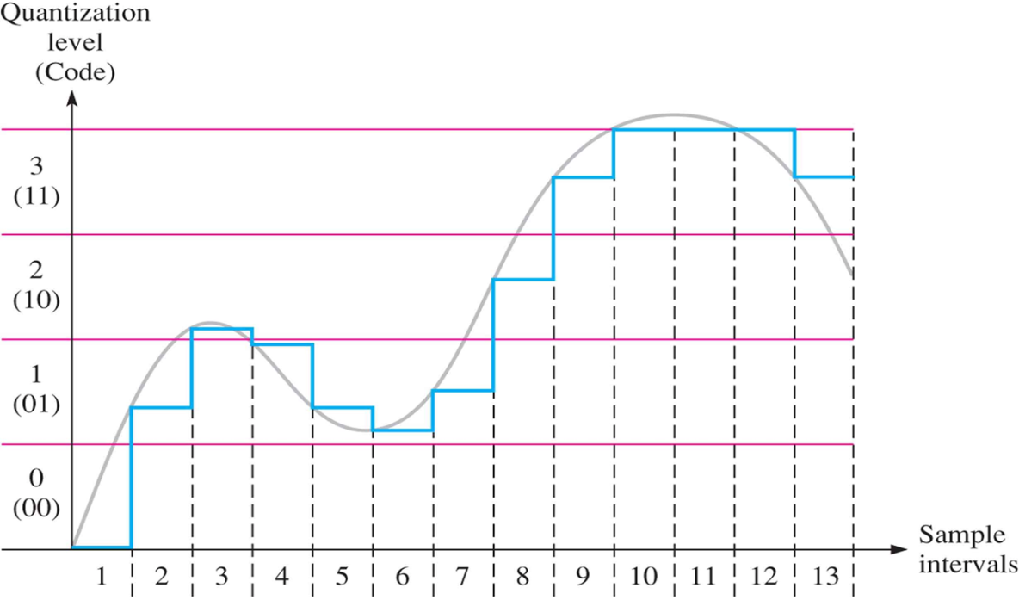
Quantization
Quantization – is a process of converting an analog value to a code. During the quantization, the ADC converts each sampled value of analog signal to a binary code. The more bits that are used to represent a sampled value, the more accurate is the representation. During the process of quantization, we lose a little bit of accuracy.
Fig 4

Slide 11
Quantization
Sample interval | Quantization level | Code
1 | 0 | 00
2 | 1 | 01
3 | 2 | 10
4 | 1 | 01
5 | 1 | 01
6 | 1 | 01
7 | 1 | 01
8 | 2 | 10
9 | 3 | 11
10 | 3 | 11
11 | 3 | 11
12 | 3 | 11
13 | 3 | 11

Slide 12
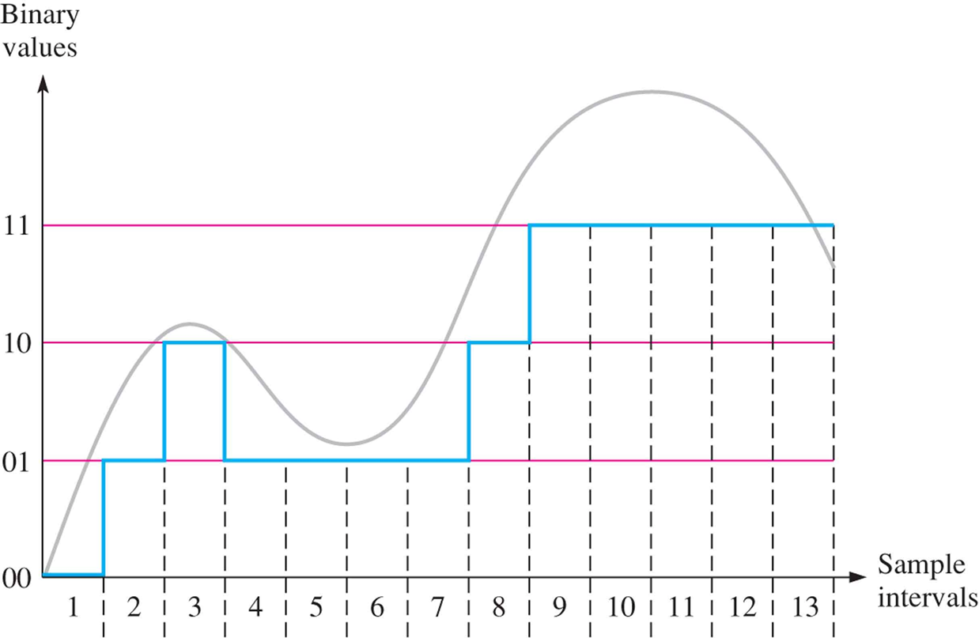
Quantization
The number of bits that the ADC uses to represent the analog signal is its resolution. The higher the resolution, the higher the number of divisions the range is broken into, and therefore, the smaller the detectable voltage change.
Fig 5
The reconstructed waveform in Figure 2 using four quantization levels (2 bits). The original analog waveform is shown in light gray for reference.

Slide 13
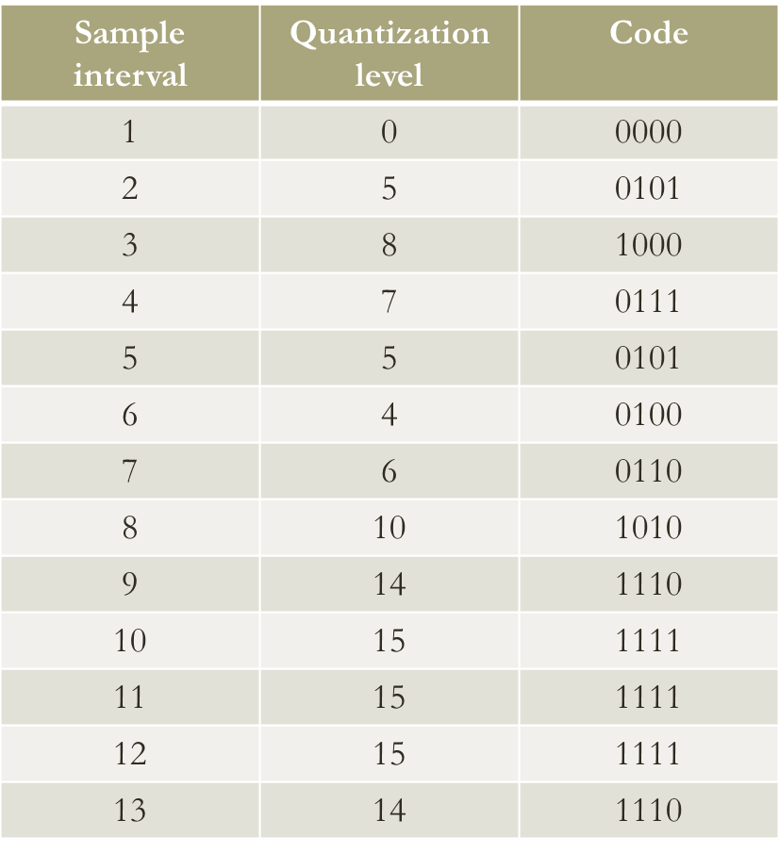
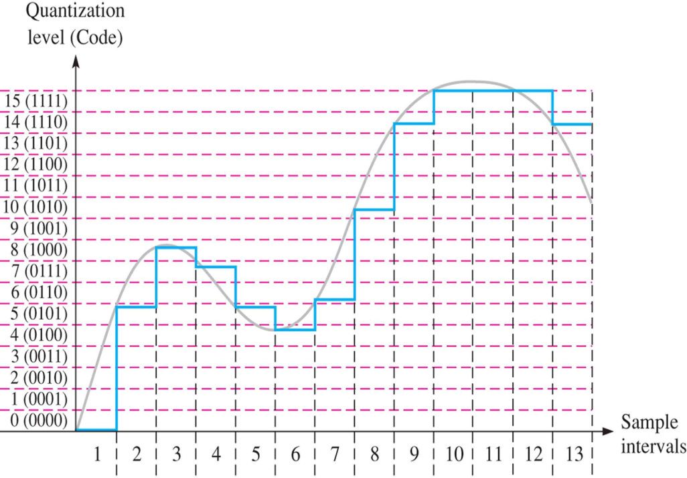
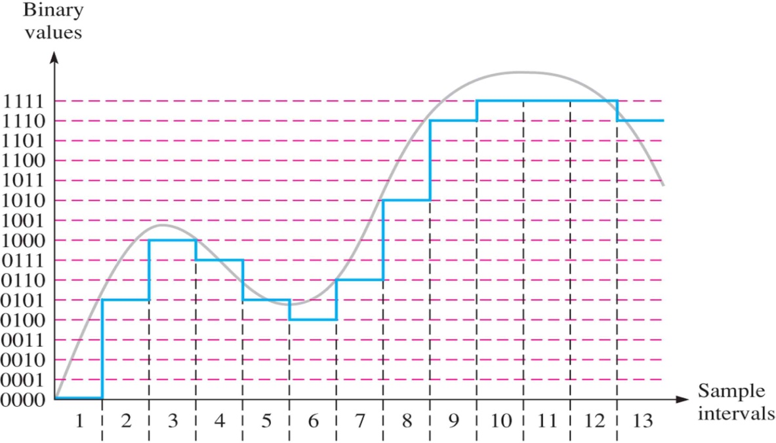
Quantization
Fig 6
Fig 7

Slide 14
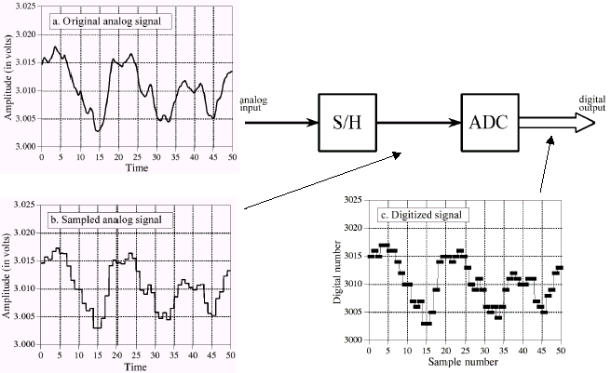
Complete ADC process

Slide 15
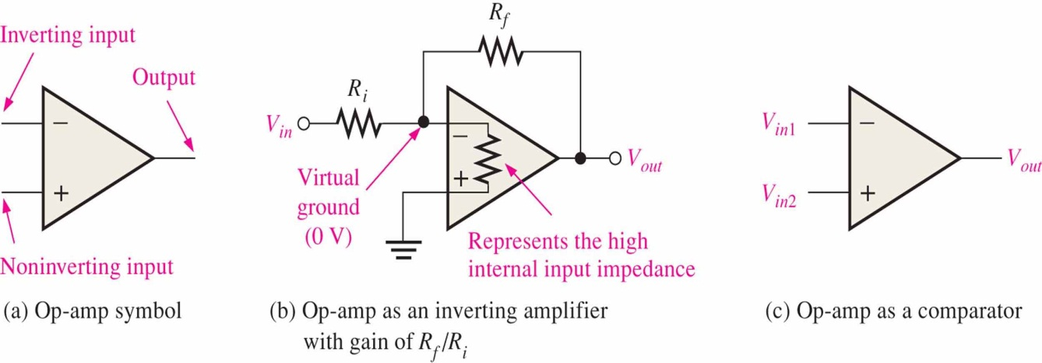
ADC implementation
Operational amplifier – op-amp is a linear amplifier which has two inputs (inverting and noninverting) and one output.
Fig 8

Slide 16
Flash Analog to Digital Converter
  For an n-bit converter, use 2n-1 comparators and 2n-1 reference voltages.
    Compare the analog input to all 2n-1 reference voltages at the same time.
      Only one comparator will produce a match.
    Pass the output of all comparators to an encoder.
      The code for the active input (the matching comparator) will be produced on the output.
  Conversion speed: 1 clock cycle.
  Very expensive.

Slide 17
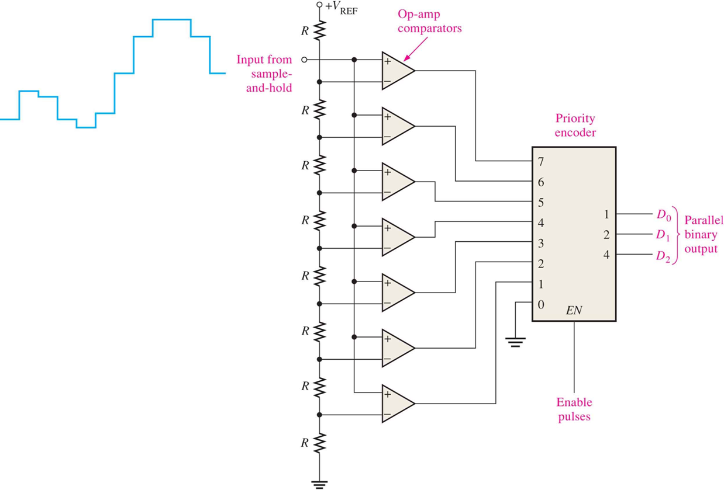
Flash Analog to Digital Converter
Fig 9

Slide 18
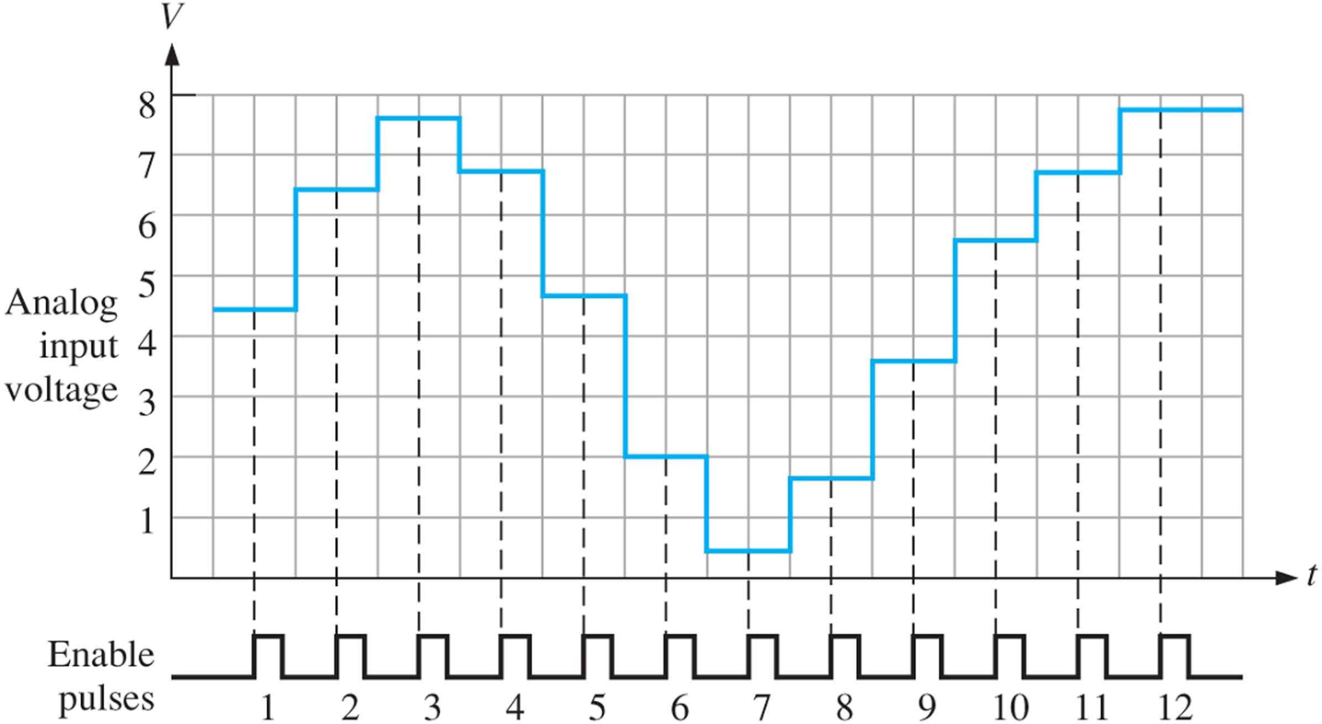
Determine the binary code output of the 3-bit flash ADC in Fig 9 for the input signal in Fig 10 and the encoder enable pulses shown. For this example, the Vref = +8V.
Fig 10

Slide 19
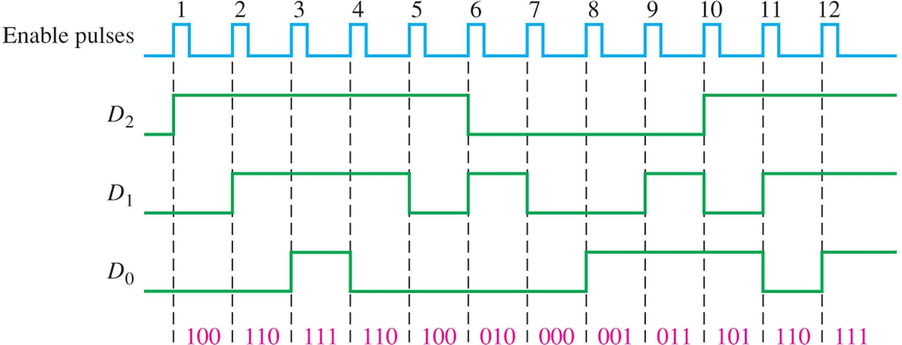
Fig 11
The large number of comparators necessary for a reasonable-sized binary number is one of
the disadvantages of the flash ADC.

Slide 20
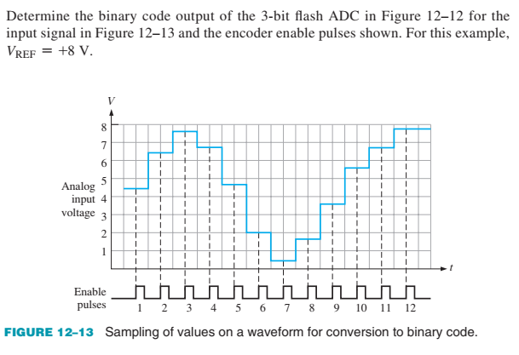
Example

Slide 21
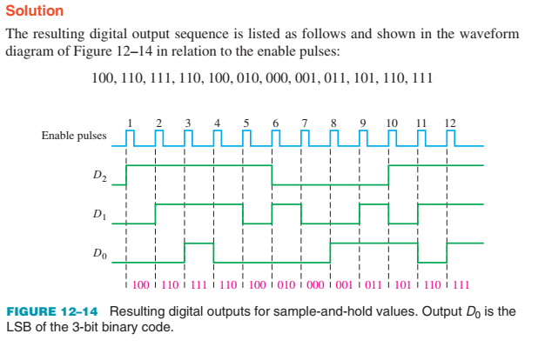
Example

Slide 22
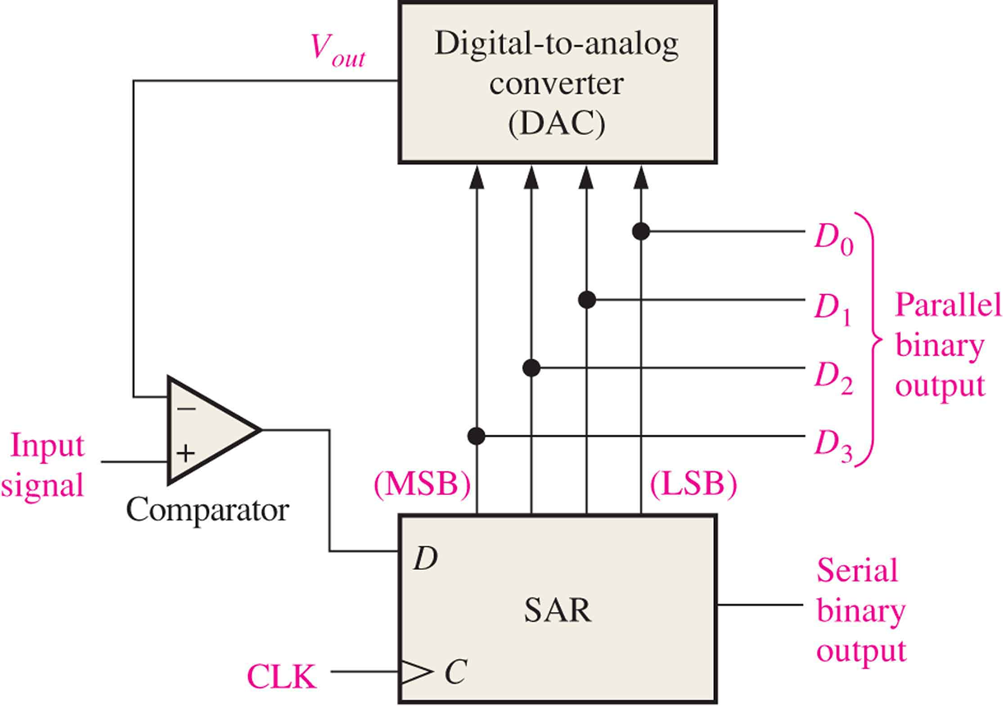
Successive Approximation Analog to Digital Converter
Fig 12

Slide 23
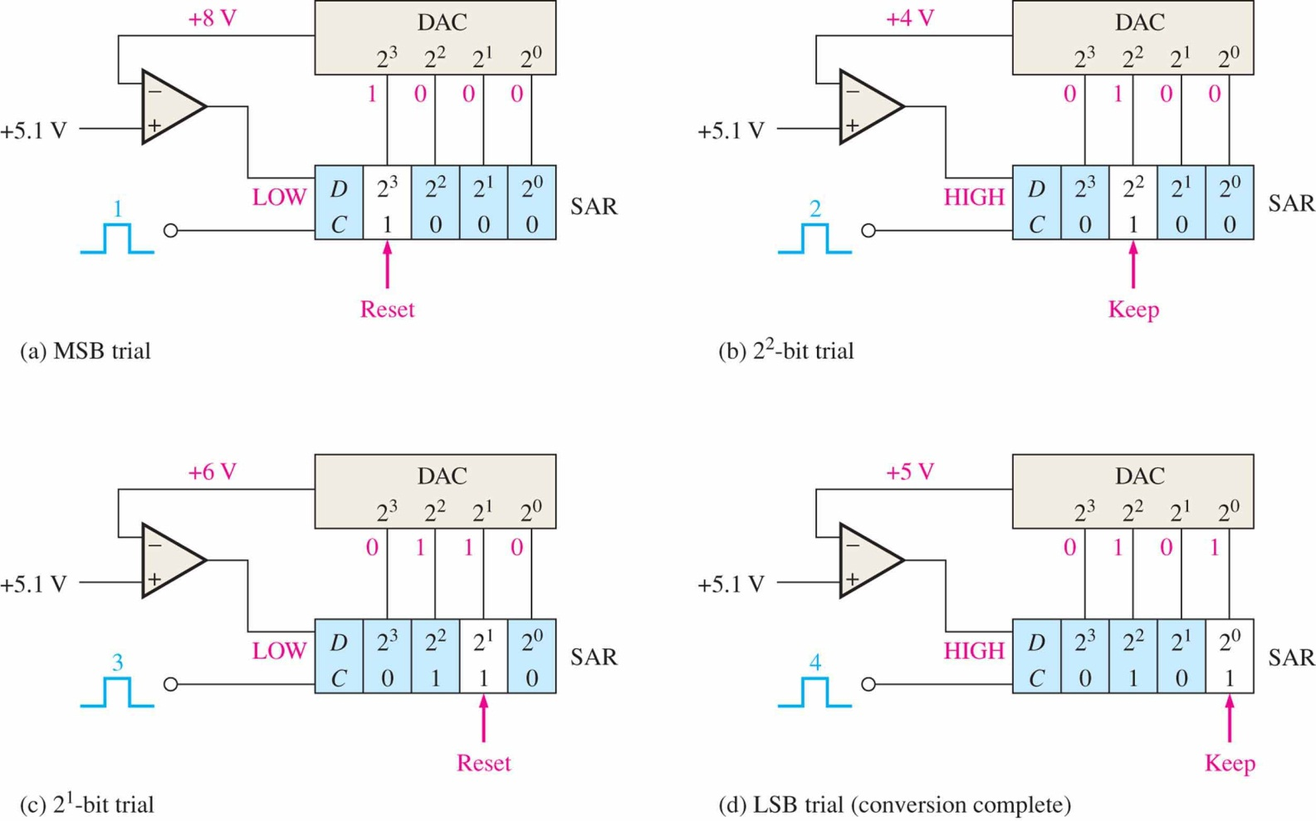
Fig 13

Slide 24

Any Questions

Slide 25
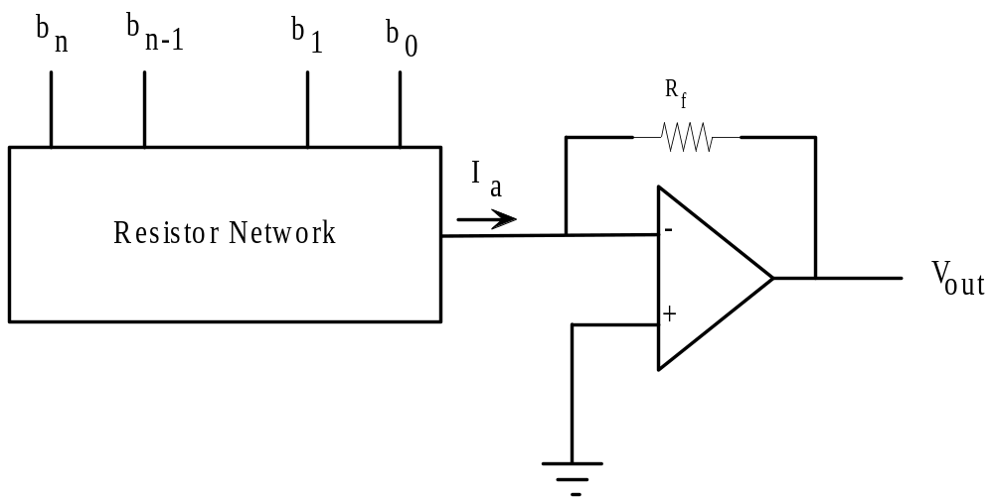
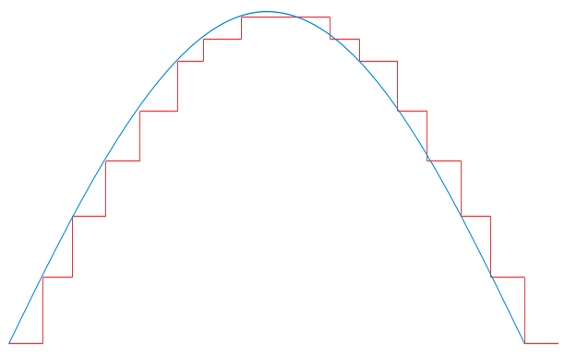
Digital to Analog Converter (DAC)
Process of taking a value represented in digital code (such as straight binary or BCD) and converting it to a voltage or current that is proportional to the digital value.
A positive half-wave from 0-10 V is shown in blue. The sample-and-hold circuit produces the staircase representation shown in red.
10 V
0 V

Slide 26
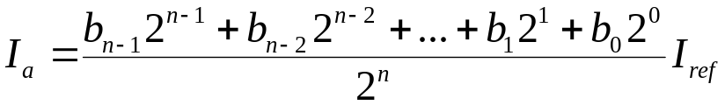
General Concept of DAC
Each digit in the digital value switches a weighted current on or off with the current of the MSB being the largest.
  The second MSB produces a current half as large, and so on.
All of the current sum at the operational amplifier’s negative input.
  The total current is given by:
  The bit values b0, b1, . . ., bn can be only 0 or 1. The function of each bit is to include or exclude a term from the general expression.
The op amp with its feedback resistor act as a current-to-voltage converter.

Slide 27
The Resistor Network
There are two main techniques to construct DAC:
  Weighted resistor network
  R-2R resistor network.
Both techniques depend on translating the voltage of each bit into a relative current. Then the currents are summed and translated into voltage.

Slide 28

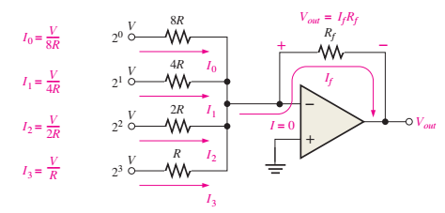
Binary-weighted-input DAC
The binary-weighted-input DAC is a basic DAC in which the input current in each resistor is proportional to the column weight in the binary numbering system. It requires very accurate resistors and identical HIGH level voltages for accuracy.
The MSB is represented by the largest current, so it has the smallest resistor. To simplify analysis, assume all current goes through R_{f} and none into the op-amp.
LSB
MSB

Slide 29
Weighted Resistor Network
The weighted resistor DAC is seldom used in practice.
One reason is the wide range of resistor values required for a large number of bits.
Another reason is the difficulty in obtaining resistors whose values are sufficiently precise.

Slide 30
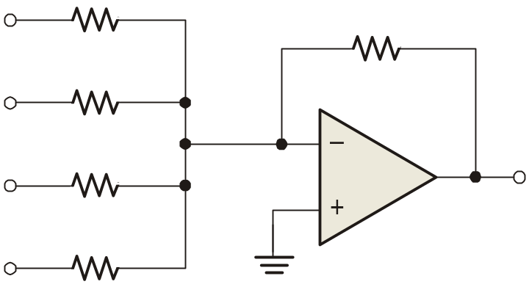
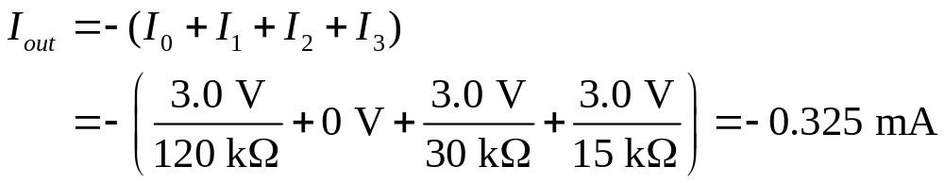

Example
Example
A certain binary-weighted-input DAC has a binary input of 1101. If a HIGH = +3.0 V and a LOW = 0 V, what is V_{out}?
120 kΩ
R_{f}
+3.0 V
60 kΩ
10 kΩ
0 V
30 kΩ
V_{out}
+3.0 V
15 kΩ
+3.0 V
Solution
V_{out} = I_{out} R_{f} = (−0.325 mA)(10 kΩ) =
−3.25 V

Slide 31
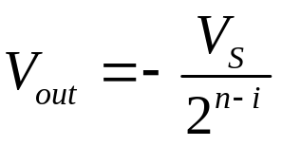
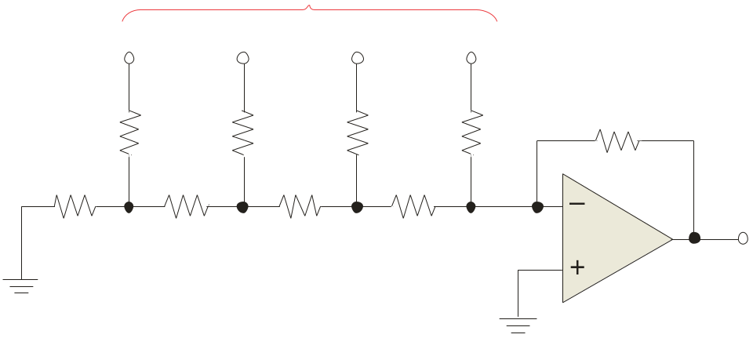
The R-2R ladder
The R-2R ladder requires only two values of resistors. By calculating a Thevenin equivalent circuit for each input, you can show that the output is proportional to the binary weight of inputs that are HIGH.
Each input that is HIGH contributes to the output:
where V_{S} = input HIGH level voltage
n = number of bits
i = bit number
Inputs
D₀
D₁
D₂
D₃
For accuracy, the resistors must be precise ratios, which is easily done in integrated circuits.
R₁
R₃
R₅
R₇
R_{f} = 2R
2R
2R
2R
2R
R₂
R₄
R₆
R₈
2R
R
R
R
V_{out}

Slide 32
R-2R Ladder Network
It can be shown using the Thevenin theorem and the principle of superposition that each bit is a separate voltage source and that the MSB, b7, is equal to VCC/2, the next to MSB, b6, is equal to VCC/4; b5=VCC/8 and so on to b0=VCC/256.
This circuit is expandable to any number of bits simply by adding one resistor of each value for each bit.

Slide 33
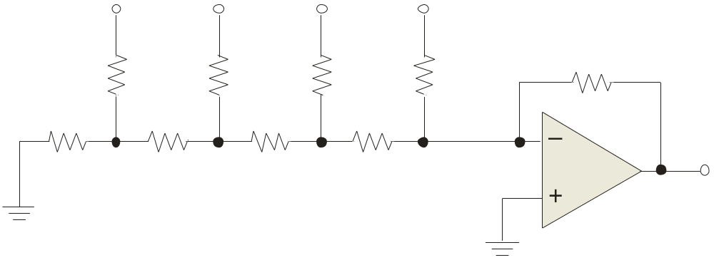

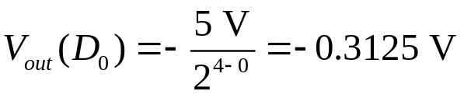
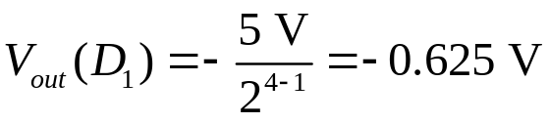
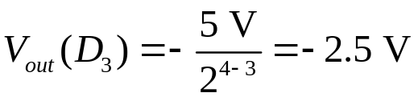
Example
Example
An R-2R ladder has a binary input of 1011. If a HIGH = +5.0 V and a LOW = 0 V, what is V_{out}?
D₀
D₁
D₂
D₃
+5.0 V
+5.0 V
0 V
+5.0 V
R₁
R₃
R₅
R₇
R_{f} = 50 kΩ
50 kΩ
50 kΩ
50 kΩ
50 kΩ
R₂
R₄
R₆
R₈
50 kΩ
25 kΩ
25 kΩ
25 kΩ
V_{out}
Solution
Apply to all inputs that are HIGH, then sum the results.
Applying superposition, V_{out} =
−3.44 V

Slide 34
Performance characteristics of a DAC
Resolution – the resolution of DAC is the reciprocal of the number of discrete steps in the output.
    For example: a 4-bit DAC has a resolution of one part in 2⁴-1. Expressed as a percentage, (1/15)*100 = 6.67%.
Offset Error – ideally, the output of a DAC will be zero volts when the binary input is all 0s. In practice however, there will be a small output voltage for this kind of situation.
Accuracy – accuracy is derived from a comparison if the actual output of a DAC with the expected output. It is expressed as a percentage of a full scale or maximum, output voltage.
    For example: if a converter has a full scale output of 10V and the accuracy ±0.1%, then the maximum error for any output voltage is (10V) (0.001) = 10 mV.

Slide 35
Any Questions

